Slide 1
Title: Traffic Management System
The components for your Traffic Management System are:
IoT devices: These devices will be responsible for collecting real-time data on traffic conditions, such as vehicle speed, volume, and occupancy. Examples of IoT devices that could be used include: Traffic cameras Road sensors GPS trackers Weather stations Lidar sensors
Data analytics: This component will be responsible for processing and analyzing the data collected by the IoT devices to identify patterns and trends in traffic flow. This information can then be used to make predictions about future traffic conditions and to develop strategies for alleviating congestion.
Python programming: Python is a powerful programming language that can be used to develop a wide range of applications, including traffic management systems. Python is well-suited for this task because it is easy to learn and use, and it has a large library of pre-built modules that can be used for data processing, machine learning, and visualization.
In addition to these three core components, your Traffic Management System may also include other components such as:
A central control system: This system will be responsible for coordinating the activities of the IoT devices and the data analytics component. It will also be responsible for making decisions about how to manage traffic flow.
A user interface: This interface will allow users to view real-time traffic conditions and to receive alerts about congestion and other incidents.

Slide 2
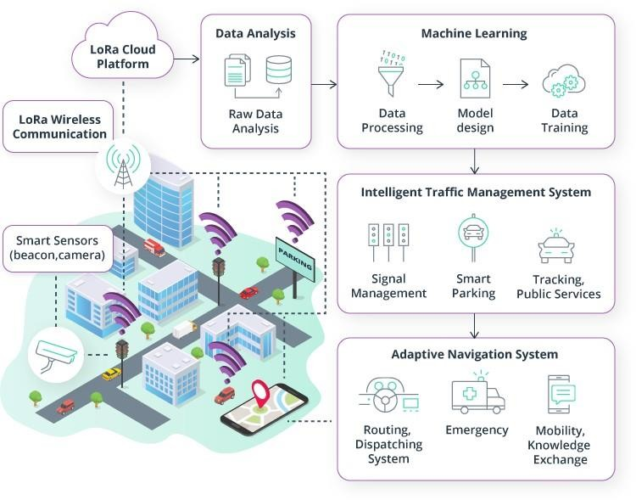
The cost of your Traffic Management System will vary depending on a number of factors, such as the size and complexity of the system, the type of IoT devices used, and the cost of the data analytics platform.
However, to give you a general idea of the costs involved, here is a rough estimate for each of the core components of your system:
IoT devices: The cost of IoT devices can vary widely depending on the type of device and the features it offers. However, you can expect to pay around $100-
$500 per device.
Data analytics: The cost of data analytics platforms can also vary widely depending on the features offered and the number of users. However, you can expect to pay around $10-$100 per month for a basic data analytics platform.
Python programming: Python is a free and open-source programming language, so there is no direct cost associated with using it. However, you may

Slide 3
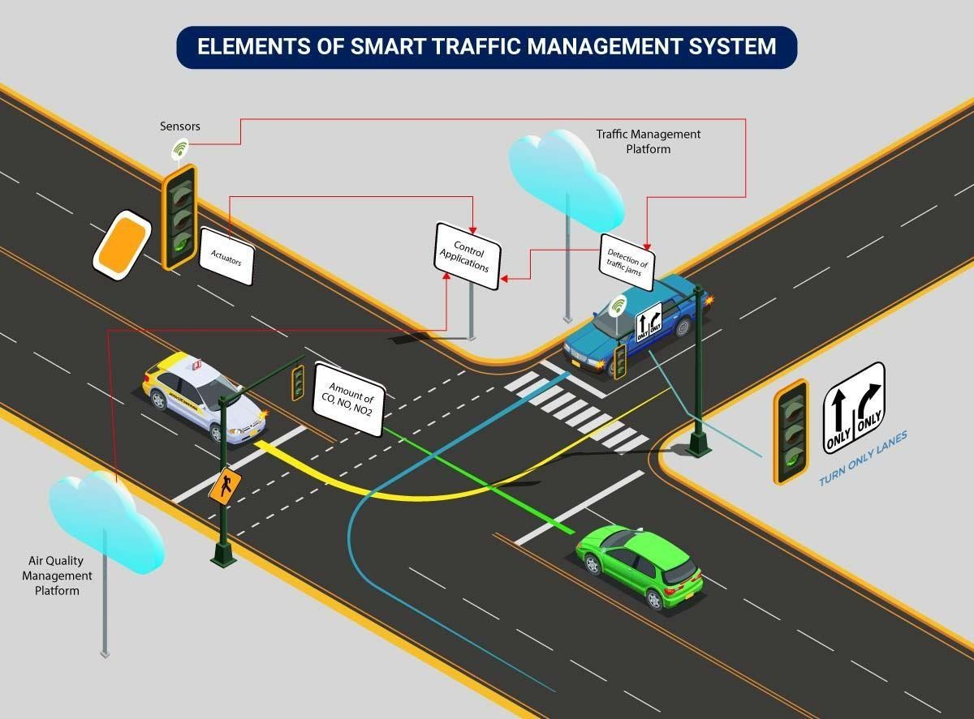
need to pay for training or support if you do not have experience with Python programming.
In addition to the cost of the core components, you will also need to factor in the cost of developing and deploying the system. This may include the cost of hiring developers, system administrators, and other IT professionals.
Overall, the cost of your Traffic Management System could range from a few thousand dollars to tens of thousands of dollars, depending on the factors mentioned above.
Here are some tips for reducing the cost of your Traffic Management System:
Use open-source software whenever possible.
Start with a small, pilot project and scale up as needed.
Consider partnering with other organizations to share costs.
Look for government or industry funding opportunities

Slide 4



Introduction:
In this Arduino tutorial, we will learn to make a Traffic management system using Arduino Uno R3. In this project, the LEDs of three different colours will blink simultaneously after a particular period of time.
You can purchase the components online or from any electronics center to do physical projects.
Whereas to do the online projects, we can use the Tinker Cad website.
Supplies:
To do this traffic management system using Arduino, we will require the following components:
Components:
Arduino Uno R3
Yellow 3 LEDs (Green, Red, and)
1 Small Breadboard
1 Green wire
5 Black wires
1 Yellow wire
1 Red wire

Slide 5

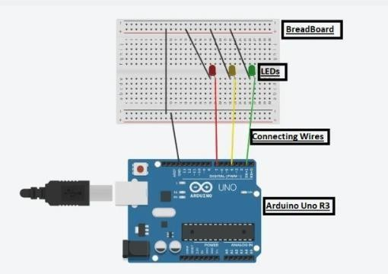
Circuit Diagram:
Steps To Create A Traffic Management System Using Arduino:
Step 1: Gather all the components on the Digital Board or Physical Table. Step 2: Place all the three LEDs on BreadBoard.
Step 3: Connect the Anode part of the LEDs to the Arduino using three coloured wires to pin numbers 7,4 and 1 of Arduino, respectively.
Step 4: Connect the cathode part of all the three LEDs to the grounding of the Arduino Uno using black coloured wire.
Step 5: The circuit is ready, input the source code and switch on the Arduino to run it.

Slide 6

Source Code:
int ledRed = 7; int ledYellow = 4; int ledGreen = 1; void setup()
{
pinMode(ledRed, OUTPUT); pinMode(ledYellow, OUTPUT);
pinMode(ledGreen, OUTPUT);
}
void loop()
{
digitalWrite(ledRed, HIGH); delay(1000); digitalWrite(ledRed, LOW);
digitalWrite(ledYellow, HIGH); delay(1000); digitalWrite(ledYellow, LOW);
digitalWrite(ledGreen, HIGH); delay(1000); digitalWrite(ledGreen, LOW);
}

Slide 7

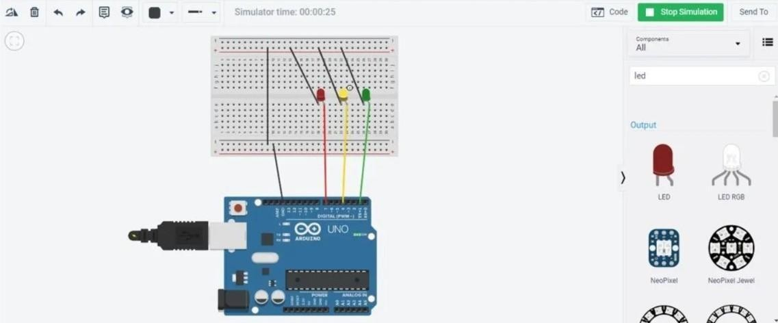
Explanation of the Code:
To make the Traffic management system, we need to input the code.
In the beginning, we initialized three variables in the name of LEDs to their respective pin numbers to which they are connected.
We have used two functions in this code, namely, setup() and loop().
The setup function is used to declare from which LED pin number we are producing the output.
In the loop function, we are producing the output as high for each pin number for some amount of time using the delay function. And thereafter, making it low.
The delay will fix the time period till which the LED will glow. The time is in milliseconds.
Output:
The LEDs will glow as per the delay function, just one after the other.
Technologies used:
User applications that allow citizens to receive instant notifications in case of traffic jams and congested routes. Desktop user apps for control rooms send commands to actuators for altering traffic signals. It helps to relieve congestion and optimize routes.
Cross-solution integrations with traffic lights or streetlight management systems. Control apps apply ML models or predefined rules to prompt appropriate output action if the air quality is poor.
Data analytics for analyzing the data from streetlight sensors on a centralized dashboard to adjust the intensity of lights

Slide 8
Python and PyQt Code
:
This code creates a simple desktop application using PyQt. It displays vehicle count and congestion levels, and you can update the data by clicking the "Update Data" button.To run this code, you'll need to install PyQt5:bashpip install PyQt5After running the script, a window with the desktop application will appear, allowing you to visualize simulated traffic data. You can replace the simulated data with real data from your IoT devices.Keep in mind that this is a basic example, and you can expand it to suit your specific needs, add additional features, and make the application more interactive or informative
import sys
from PyQt5.QtWidgets import QApplication,
QMainWindow, QLabel, QPushButton,
QVBoxLayout, QWidgetimport
randomclass TrafficManagementApp(QMainWindow):
def _init_(self):
super()._init_()
self.init_ui()
def init_ui(self):
self.setWindowTitle('Traffic Management System') self.setGeometry(100, 100, 400, 200)
self.central_widget = QWidget() self.setCentralWidget(self.central_widget) self.vehicle_count_label = QLabel('Vehicle Count: 0', self) self.congestion_level_label = QLabel('Congestion Level: Low congestion', self)
self.update_button = QPushButton('Update Data', self) self.update_button.clicked.connect(self.update_data)

Slide 9
def update_data(self):
# Simulate real-time data with random values for demonstration
vehicle_count = random.randint(0, 100) congestion_level=self.calculate_congestion_level(vehicle_count)
self.vehicle_count_label.setText(f'Vehicle Count: {vehicle_count}') self.congestion_level_label.setText(f'Congestion Level: {congestion_level}')
def calculate_congestion_level(self, vehicle_count):
if vehicle_count > 80:
return "High congestion"
elif vehicle_count > 40:
return "Moderate congestion"
else:
return "Low congestion"def main():
app =QApplication(sys.argv) window=TrafficManagementApp()
window.show()
sys.exit(app.exec_())
if _name_ == '_main_': main()

